Slide 1

Citizen college kumaripati, lalitpur
Submitted by: Submitted to:
Aaditya Paudel Dhiraj Bashyal

Slide 2
Introduction to iterative model
# What is iteration?
Ans: Acting of iterating or repeating.
Iterative model is a software development lifecycle (SDLC) approach in which the initial development work is conducted based on initial requirements that are clearly defined.
.

Slide 3
Theoritical background
In this model, we can start with some software specification and develop first version of the software.
If there is need to change the software, new version of the software is created with new iteration.

Slide 4
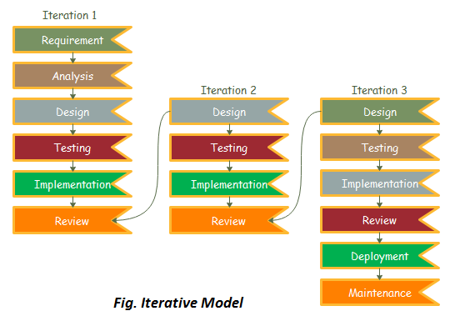

Slide 5
Various phases of iteration model
Requirement gathering and analysis:
In this phase, requirements are gathered from customer and checked by an analyst whether the requirements will fulfill or not.
Design:
Software development team design the software by different diagrams like; data flow diagram(DFD), activity diagram, state transition diagram, etc.

Slide 6
Implement
Requirements are written in coding language and transformed into computer programs which is known as software.
Testing:
After completing coding phase, software testing starts using different test methods like: white box, grey box, black box methods, etc.
Deployment :
After completing all the phase, software is deployed to its work environment.

Slide 7
Review:
In this phase, if there are any errors found in the software then, the process starts again from requirement gathering.
Maintenance:
This phase involves debugging and new addition option.

Slide 8
Advantages of iterative model
Testing and debugging during small iteration is easy.
It is easily acceptable to ever changing needs of the project.
Risks are identified during iteration and resolved.

Slide 9
Disadvantage of iterative model
It is not suitable for smaller project.
More resources may be required.
Design can be changed due to imperfect requirements.
Requirement changes can use over budget.

Slide 10
# when to use iterative model?
Ans:
When the requirements are defined and easy to understand.
When software application is large.
When there is requirement of changes in future.

Slide 11
